Slide 1
Functional Programming in Java

Slide 2
Modules
Functional Programming
Lamda Expression
Optional Class
Stream API
Functional Interface
Method Reference
1
2
3
4
5
6

Slide 3
Functional Programming
It is a declarative style of programming rather than imperative.
The basic objective of this style of programming is to make code more concise, less complex, more predictable, and easier to test compared to the legacy style of coding.

Slide 4
Functional Programming
Functional Interface
Lamda Expression
Method reference
Streams API
Optional class

Slide 5
Functional Interface

Slide 6
Functional Interface
Functional Interfaces introduced in Java 8 allow us to use a lambda expression to initiate the interface's method and avoid using lengthy codes for the anonymous class implementation.
Various built-in interfaces were declared with @FunctionalInterface annotation and made functional from Java 8.

Slide 7
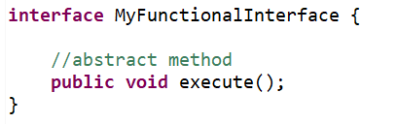
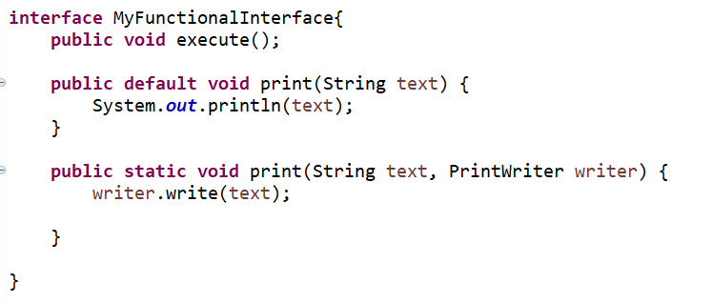
Functional Interfaces
An interface that contains exactly one abstract method is known as a functional interface.
Functional Interface can have any number of default, static methods which are introduced in Java 8 but can contain only one abstract method
We can use @FunctionalInterface annotation to mark an interface as Functional Interface

Slide 8
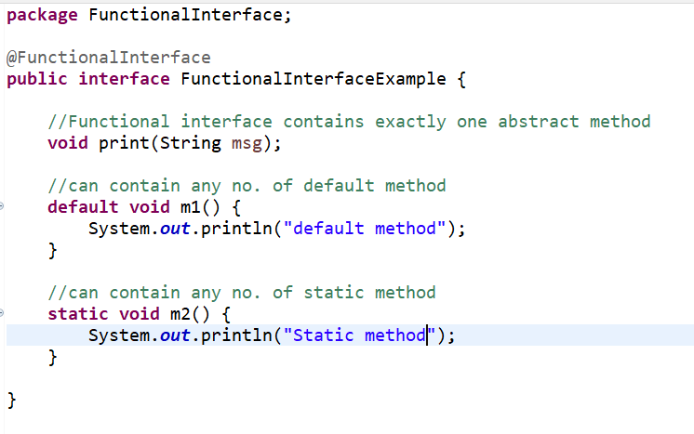
Defining functional interface using annotation
It can contain any number of default and static method
The @FunctionalInterface annotation is strictly informational: it's never necessary to use it. The Java compiler can recognize functional interfaces with or without @FunctionInterface.

Slide 9
Benefits of Functional Interface
It is possible to create abstractions that multiple classes can use
Especially helpful when developers need to create a complex abstraction with various methods and behaviors.
Difference between Functional Interface and Abstract Class
Any interface with a single abstract method other than static and default methods is considered a functional interface.
We can use this feature to restrict the number of abstract methods to be declared.
While in abstract classes, we can never have this restriction on the number of abstract methods declaration.

Slide 10
Built-In Functional Interfaces in Java
Few Others Are:-
Comparator
Runnable
Callable
Future
Functional Interfaces
Function
Consumer
Predicate
Supplier

Slide 11
Predefined Functional Interfaces example:
Package – java.util.function is introduced
Functional interfaces provide target types for lambda expressions and method references.
Some of the frequently used predefined interfaces:
Function <T,R> -> Represents a function that accepts one argument and produces a result.
Consumer<T> -> Represents an operation that accepts a single input argument and returns no result. For e.g., this function simply accepts a string and prints it
Supplier<T> -> Represents a supplier of results.
Predicate<T>Represents a predicate (boolean-valued function) of one argument.

Slide 12
Lambda Expression

Slide 13
Lambda Expression to implement Functional Interface
Lambda expression provides implementation of functional interface.
An interface which has only one abstract method is called functional interface.
Java provides an annotation @FunctionalInterface, which is used to declare an interface as functional interface.

Slide 14
Lambda Expressions
Lambda expression is an anonymous function. It’s a function without name and does not belong to any class
It is mainly used to implement functional interfaces
Lambdas are functions that exist in isolation. They don’t depend on any class for their visibility/usability
Lambda Expression Syntax includes –
() -> {}
Lambda Input Parameters
Arrow (Denoting Lambda)
Lambda Body

Slide 15
Why Lambdas?
Enables functional programming also known as a paradigm shift– we are used to writing object oriented programs in java
Readable and concise code – eliminates some boiler plate code in certain scenarios
Easier-to-use APIs and libraries
Enables support for parallel processing - Parallel processing is a method in computing of running two or more processors (CPUs) to handle separate parts of an overall task. Breaking up different parts of a task among multiple processors will help reduce the amount of time to run a program.

Slide 16
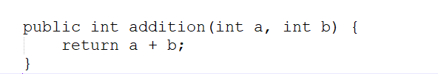
Lambda vs Method
Method is always belongs to a class or object in Java where as Lambda does not belong to any class or object
Method has the main parts :
Name
Parameter List
Body
Return Type
Name
Parameter List
Return Type
Body

Slide 17

Lambda vs Method
Lambda expression in Java has these main parts:
Do’s:-
Parameter List
Body – This is the main part of the function
Don’t:-
No Name – As Lambda is an anonymous function so no need to have a name
No Access Modifier – modifiers makes sense in methods, classes and objects, hence no modifier
No Return Type – No need to mention the return type in the lambda expression. The Java 8+ compiler infers the return type by checking the code
Parameter List
Body

Slide 18
Lambda Expression with one small addition of ->
So, in order to write a Lambda expression, take a method -> remove access modifier ->remove the return type and method name and you have your expression.
We are now able to assign the lambda expression to a variable.
In case we have just one body line then we can omit the braces as well.
aBlockOfCode = () -> { System.out.println(“Hello world”) }
aBlockOfCode = () ->System.out.println(“Hello world”)

Slide 19
Different Ways to use Lambda Expressions

Slide 20
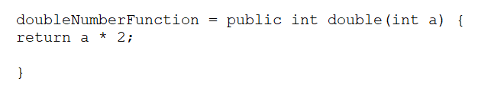


Lambdas with Single Parameter
Example: - Let us write a function that takes in a integer and returns a double of that. In Structured programming we would write it as
Earlier we learnt that while using Lambda expression we can simply omit unnecessary details of code like access modifier, method name, return type. So now the same code can be written using lambda as: -
If it is a single line of code we can also omit using ‘return’ keyword when not using { } braces

Slide 21

Lambdas with Two Parameters
Example- Adding two numbers can be written as -

Slide 22
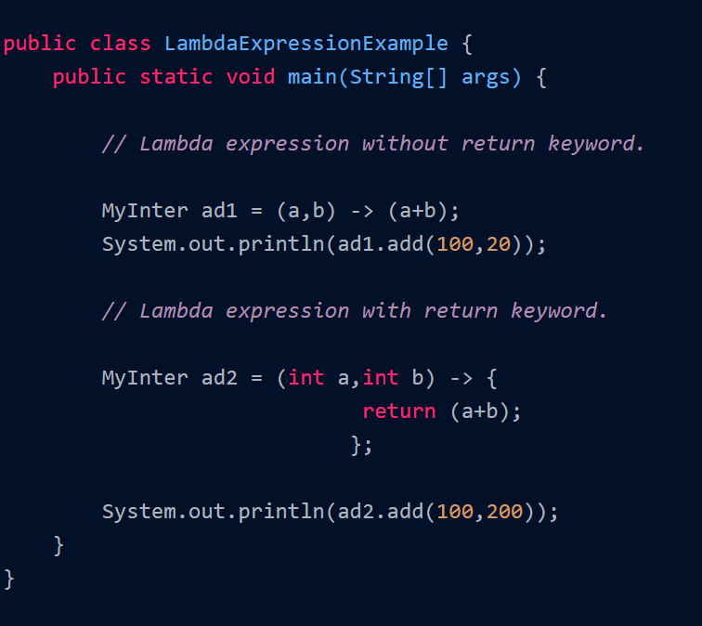
Simple Lambda Expression

Slide 23
Method References

Slide 24
Method References
Method Reference is used to refer method of the functional interface. It is a compact and easy form of a lambda expression
Each time when you are using a lambda expression to just refer a method, you can replace your lambda expression with a method reference. E.g.,
Printable printableLambda = (String msg) -> System.out.println(msg) printableLambda.print("Hello");
Printable printable = System.out::println;
printable.print("Hello");

Slide 25
Types of Method References
There are four types of method references in Java:
Reference to static method
    Syntax is Class::StaticMethodName
Reference to an instance method of a particular object
-> Syntax is Object::instanceMethodName
Reference to an instance method of an arbitrary object of specific type:
-> Syntax is Class::instanceMethodName
4. Reference to a constructor
->Syntax is ClassName::new

Slide 26
Streams API

Slide 27
Streams
It is a sequence of elements supporting sequential and parallel aggregate operations
Streams are wrappers around a data source, allowing us to operate with that data source and making bulk processing convenient and fast.
A stream does not store data and, in that sense, is not a data structure. It also never modifies the underlying data source.
It extends the BaseStream
Advantages of Streams
Using Streams will make you a more efficient Java Programmer
It makes extensive use of Lambda Expressions
A Stream pipeline consists of a source, followed by zero or more intermediate operations and a terminal operation

Slide 28
Types of Stream Operations in Java
Stream Source
  Streams can be created from Collections, Lists, Sets, ints, longs, doubles, arrays, lines of a file
Stream Operations are either intermediate or terminal
  Intermediate Operations such as filter, map or sort return a stream so we can chain multiple intermediate operations
  Terminal Operations such as forEach, collect or reduce are either void or return a non-stream result
Source
Filter
Sort
Map
Collect

Slide 29
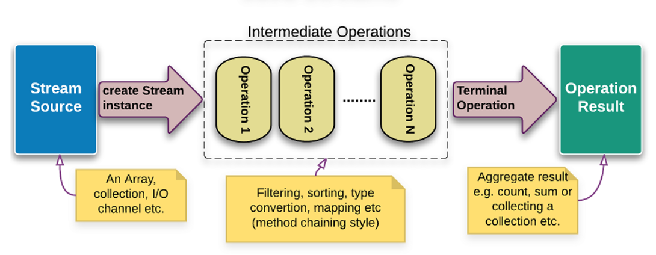
Stream Source and Operations
Intermediate Operations : Filter, Map, Sort return a stream to chain multiple operations
Terminal Operations : forEach, collect or reduce return a non-stream result

Slide 30
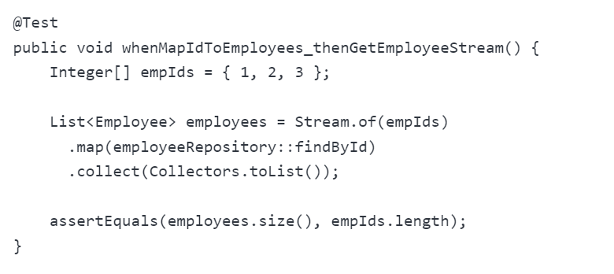
map()
map() produces a new stream after applying a function to each element of the original stream. The new stream could be of different type.
The following example converts the stream of Integers into the stream of Employees:

Slide 31
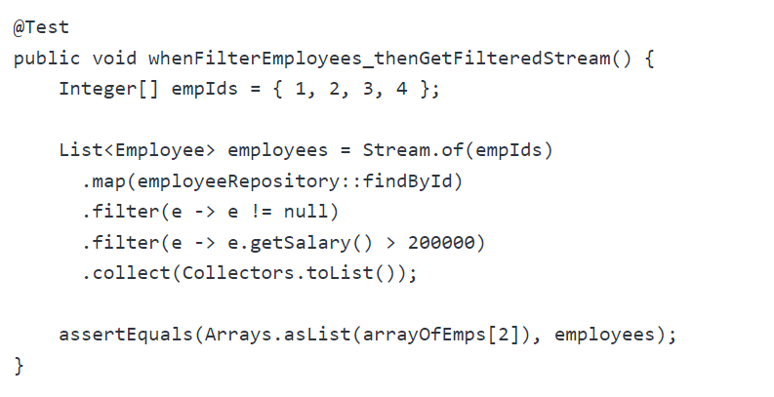
filter()
filter(); this produces a new stream that contains elements of the original stream that pass a given test

Slide 32
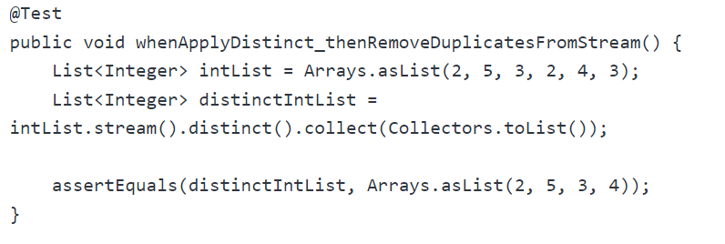
reduce()
A reduction operation (also called as fold) takes a sequence of input elements and combines them into a single summary result by repeated application of a combining operation.

Slide 33
Optional class

Slide 34
Optional class
Every Java Programmer is familiar with NullPointerException.
It can crash your code and it is very hard to avoid it without using too many null checks.
So, to overcome this, Java 8 has introduced a new class Optional in java.util package.
It can help in writing a neat code without using too many null checks.
By using Optional, we can specify alternate values to return or alternate code to run.
This makes the code more readable because the facts which were hidden are now visible to the developer.

Slide 35
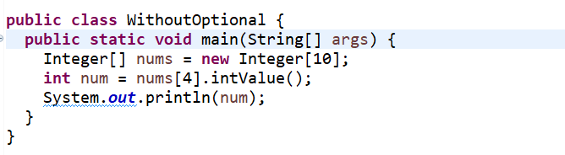

Java Program Without Using Optional Class
Output:

Slide 36
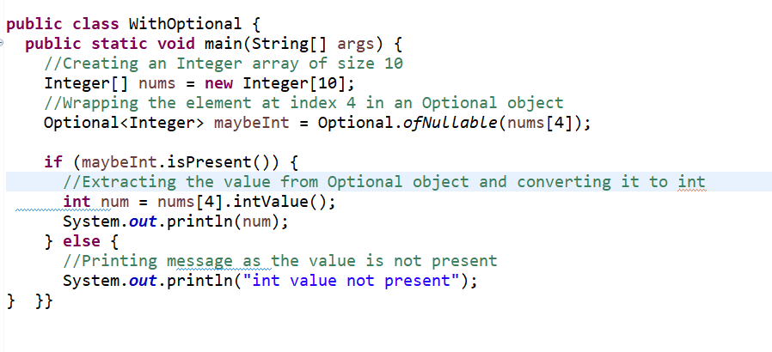
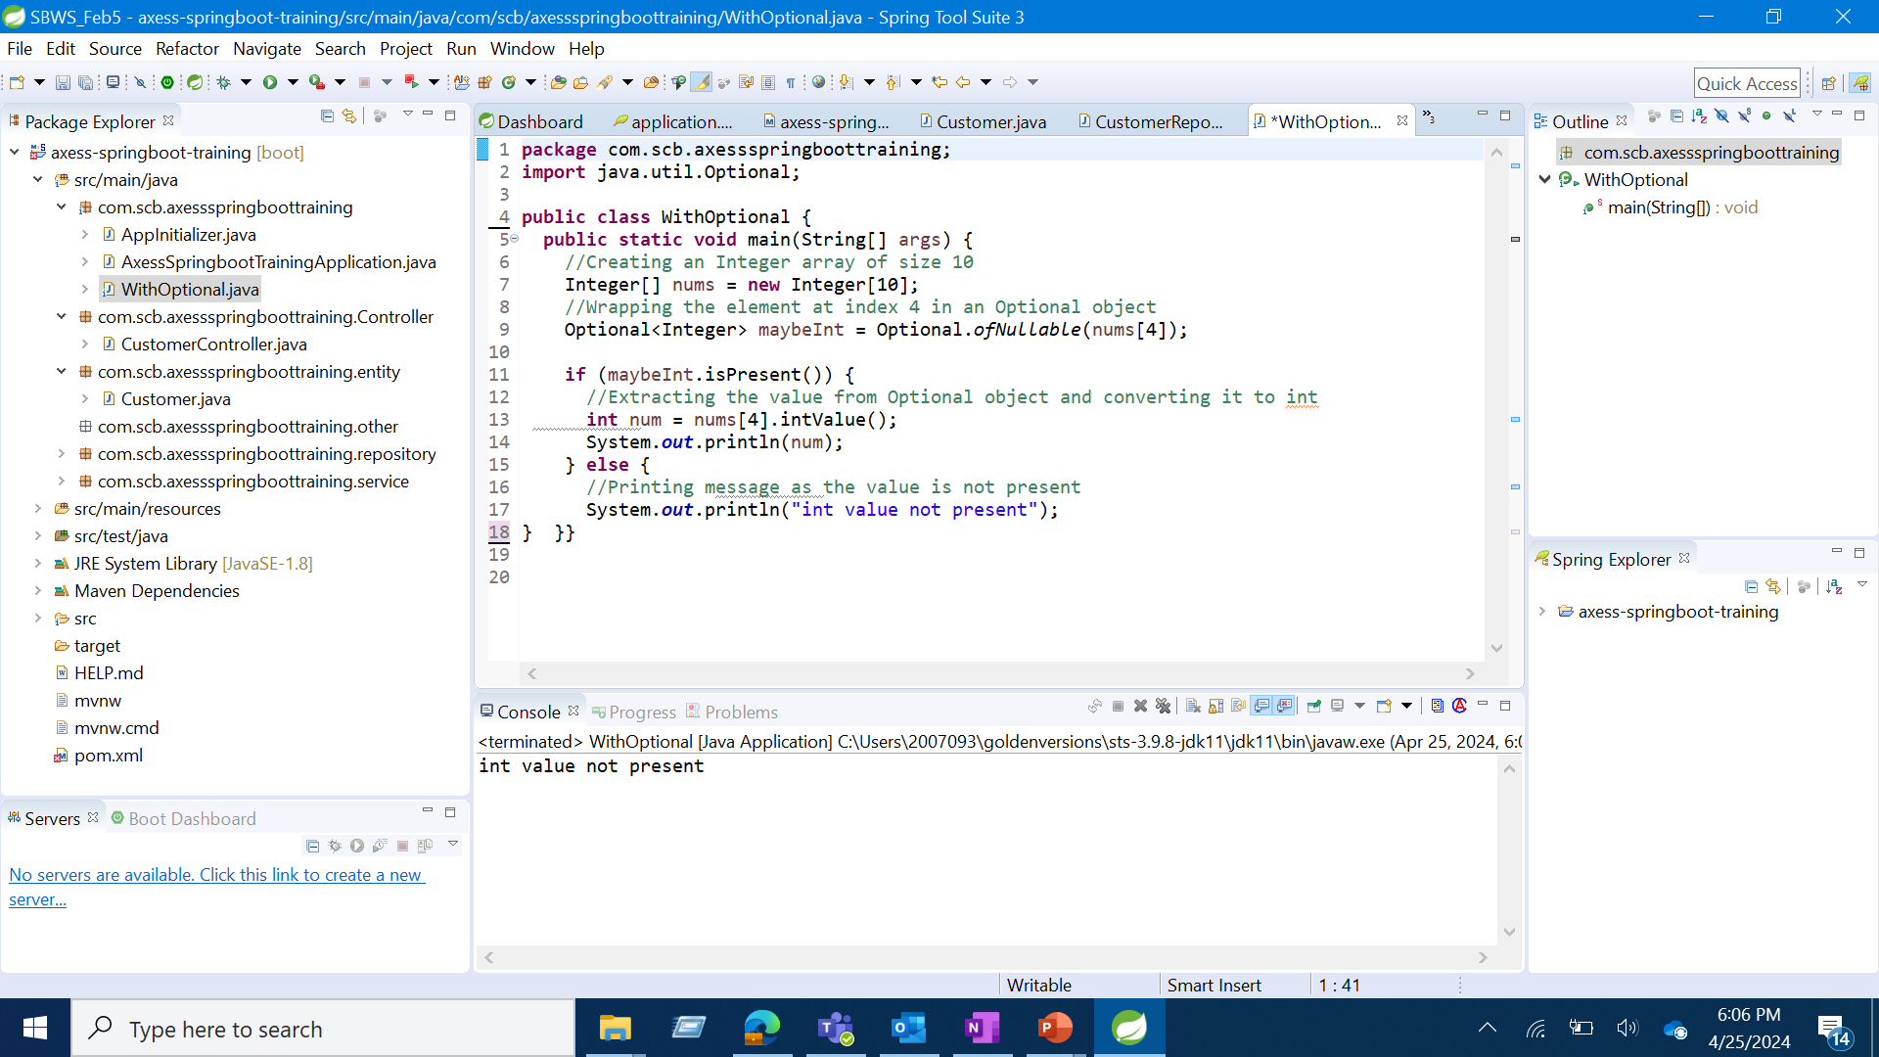
Java Program With Optional Class
output

Slide 37
Use case
From the existing use case, validate email field using regular expression.
Find unique customers from specific location and sort based on customer name (ascending order)
Print all customer name in the following format
  Hi firstname lastname
Calculate the bonus using the existing salary
  Bonus = salary * 0.1
List all the available departments in each of the location

Slide 38
Thank You

